Slide 1
ATAI
Advanced Techniqueof Artificial Intelligence
ATAI
ChongqingUniversity _{AdvancedTechniqueof}
of Technology Artificial Intelligence
Chongqing University of
Technology
Chongqing University ^{ATAI}
_{of Technology} Advanced Techniqueof
Artificial Intelligence
Chongqing University of Technology
Chongqing University of Technology
Hierarchical Semantic Enhancement Network for Multimodal
Fake News Detection
Code:None
2023.12.3 •ChongQing
—— ACM MM23
Reported by Ling Tan
1

Slide 2
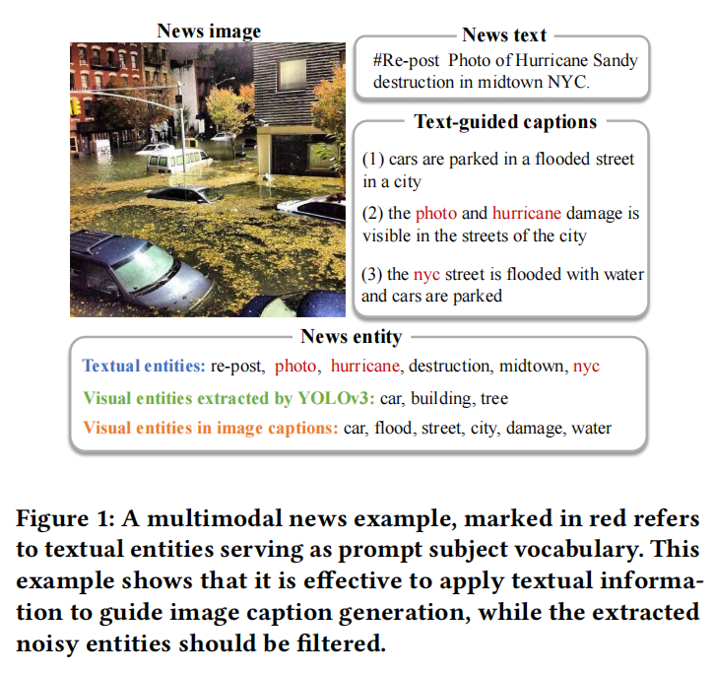
ATAI
AdvancedTechniqueof
Artificial Intelligence
ATAI
ChongqingUniversity _{AdvancedTechniqueof}
of Technology Artificial Intelligence
ChongqingUniversity of Technology
Motivation
（1）None of current methods make full use of the semantic information of the image, especially without combining text information for semantic extraction of image specific content.
（2）These methods tend to ignore the additional noise impact that comes with adding external knowledge. When extracting visual or textual entities, irrelevant entities are often identified, which tend to introduce varying degrees of noise information into the model.

Slide 3
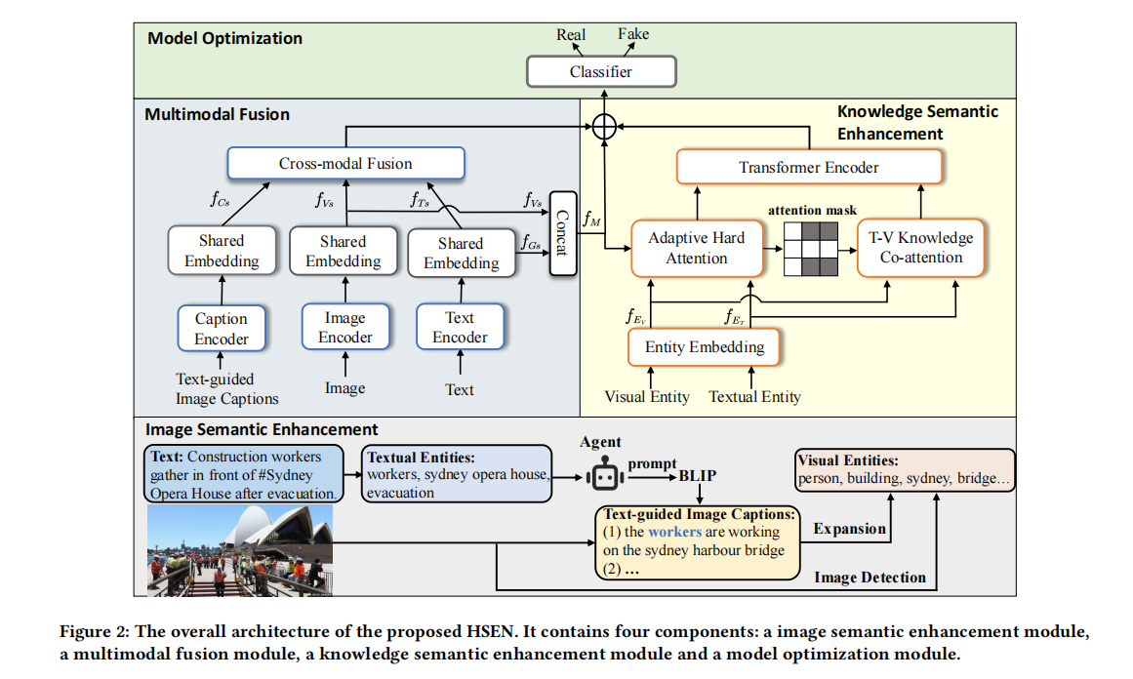
ChongqingUniversity of Technology
ATAI
AdvancedTechniqueof
Artificial Intelligence
ATAI
ChongqingUniversity _{AdvancedTechniqueof}
of Technology Artificial Intelligence
Overview

Slide 4
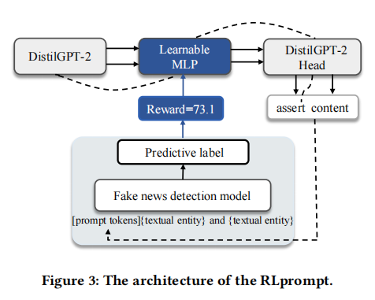
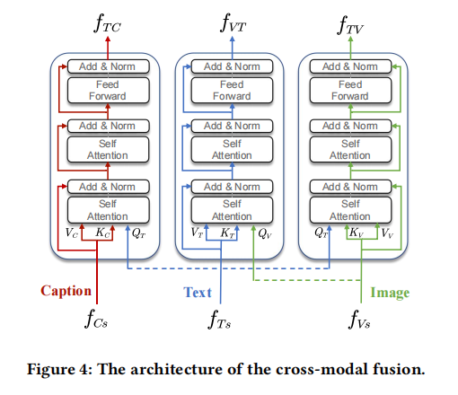
ChongqingUniversity of Technology
ATAI
AdvancedTechniqueof
Artificial Intelligence
ATAI
ChongqingUniversity _{AdvancedTechniqueof}
of Technology Artificial Intelligence
Overview

Slide 5
ChongqingUniversity of Technology
ATAI
AdvancedTechniqueof
Artificial Intelligence
ATAI
ChongqingUniversity _{AdvancedTechniqueof}
of Technology Artificial Intelligence
Overview

Slide 6
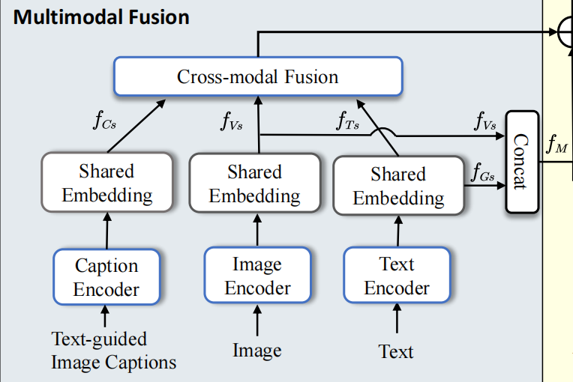
ChongqingUniversity of Technology
ATAI
AdvancedTechniqueof
Artificial Intelligence
ATAI
ChongqingUniversity _{AdvancedTechniqueof}
of Technology Artificial Intelligence
Method

Slide 7
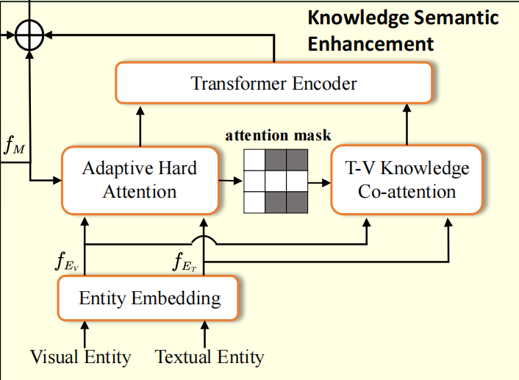
ChongqingUniversity of Technology
ATAI
AdvancedTechniqueof
Artificial Intelligence
ATAI
ChongqingUniversity _{AdvancedTechniqueof}
of Technology Artificial Intelligence
Method

Slide 8
ChongqingUniversity of Technology
ATAI
AdvancedTechniqueof
Artificial Intelligence
ATAI
ChongqingUniversity _{AdvancedTechniqueof}
of Technology Artificial Intelligence
Method

Slide 9
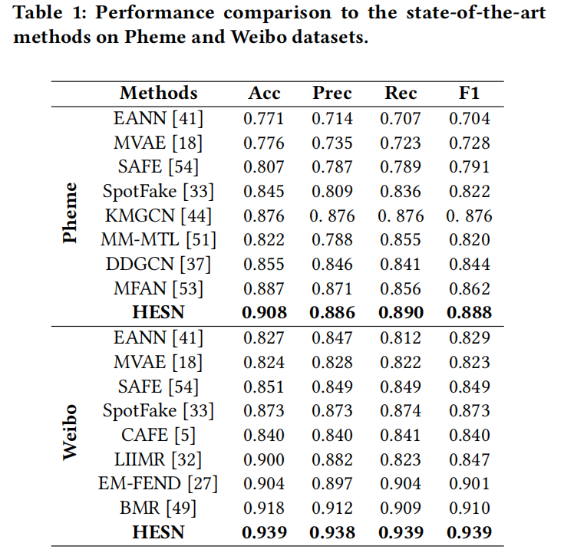
ATAI
AdvancedTechniqueof
Artificial Intelligence
ATAI
ChongqingUniversity _{AdvancedTechniqueof}
of Technology Artificial Intelligence
ChongqingUniversity of Technology
Experiments

Slide 10
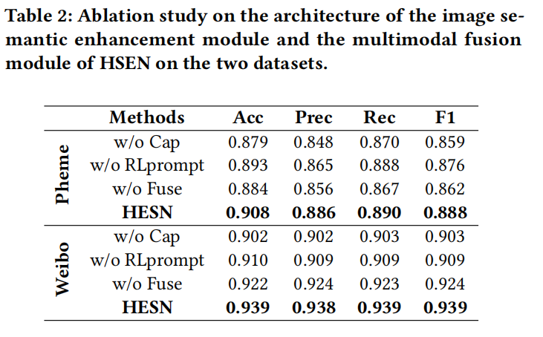
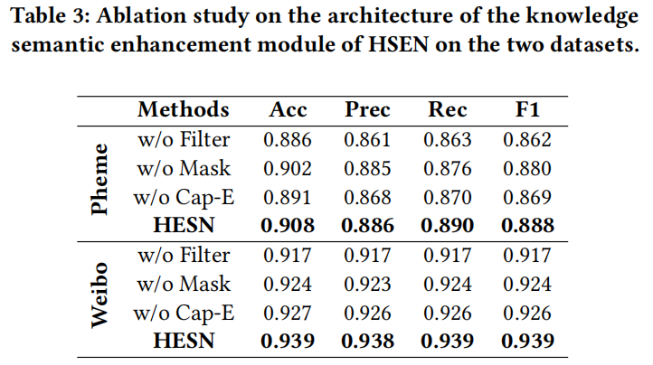
ATAI
AdvancedTechniqueof
Artificial Intelligence
ATAI
ChongqingUniversity _{AdvancedTechniqueof}
of Technology Artificial Intelligence
ChongqingUniversity of Technology
Experiments

Slide 11
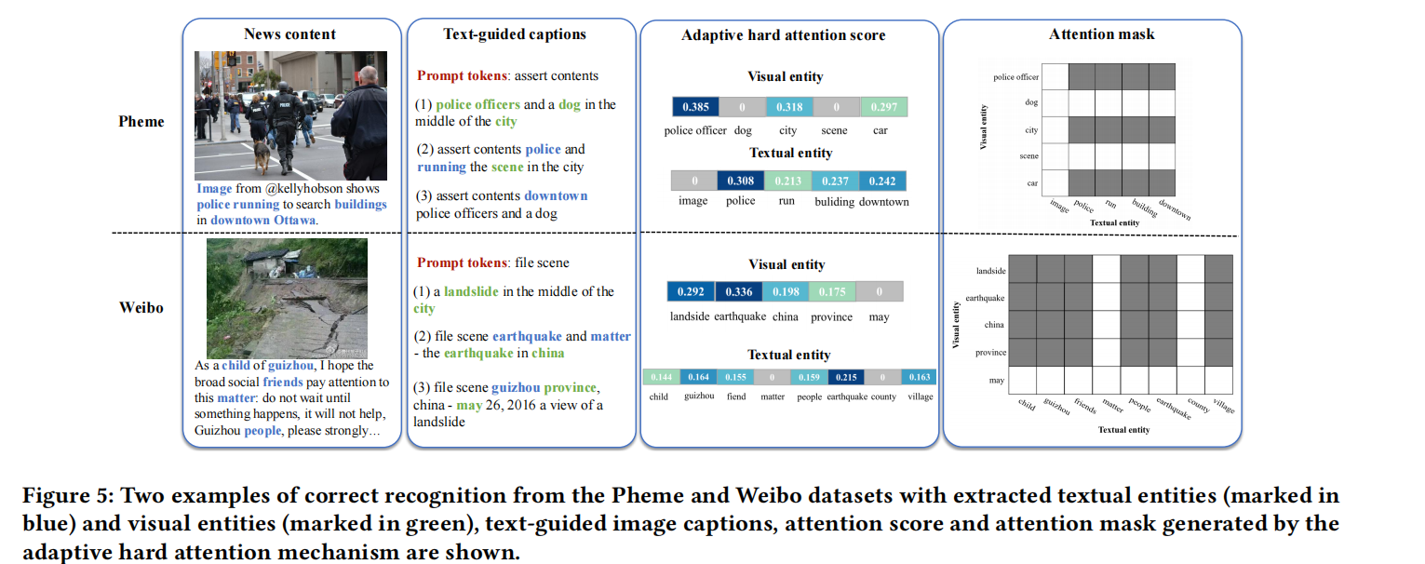
ATAI
AdvancedTechniqueof
Artificial Intelligence
ATAI
ChongqingUniversity _{AdvancedTechniqueof}
of Technology Artificial Intelligence
ChongqingUniversity of Technology
Experiments

Slide 12
ChongqingUniversity of Technology
ATAI
AdvancedTechniqueof
Artificial Intelligence
ATAI
ChongqingUniversity _{AdvancedTechniqueof}
of Technology Artificial Intelligence
Thanks!

